Slide 1

CSE- 208
Algorithms Lab
Lab: 13
Backtracking
Fahad Ahmed
Lecturer, Dept. of CSE
E-mail: fahadahmed@uap-bd.edu

Slide 2


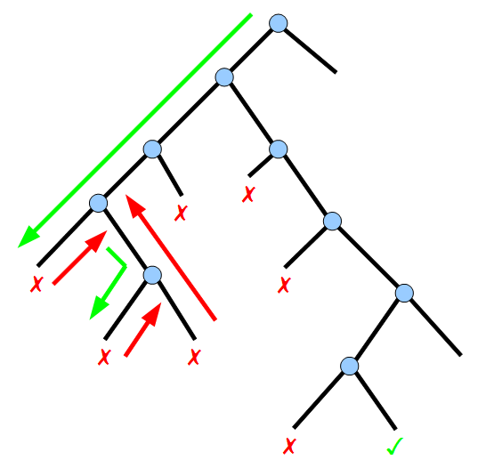
Backtracking

Slide 3
Task-13
Problem:
Implement the following algorithm using backtracking approach :
N Queen Problem
Rat in a Maze
The Knight’s tour problem

Slide 4
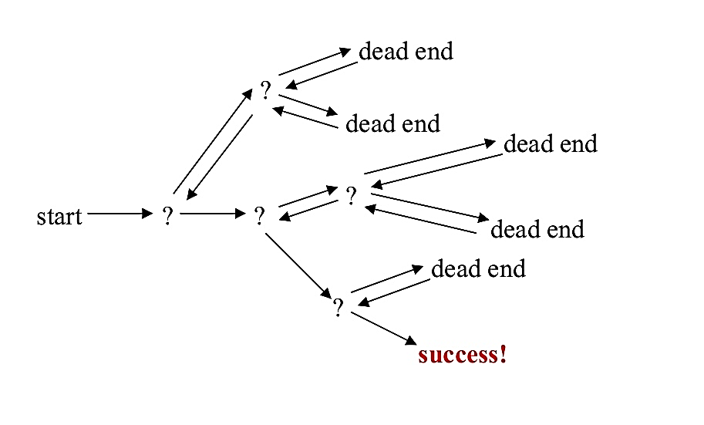
Backtracking
What is Backtracking?
According to the wiki definition,
Backtracking can be defined as a general algorithmic technique that considers searching every possible combination in order to solve a computational problem.

Slide 5
Backtracking
How to determine if a problem can be solved using Backtracking?
Every constraint satisfaction problem which has well-defined constraints can be solved by Backtracking.
There are three types of problems which can be solved using backtracking :
Decision Problem : Search for a feasible solution
Optimisation Problem : Search for the best solution
Enumeration Problem : Find all feasible solutions

Slide 6
Which problem are solved by using backtracking procedure?
N Queen Problem
The Knight’s tour problem
Rat in a Maze
m Coloring Problem or Graph coloring problem
Subset Sum
Binary strings : generating all binary strings
Generation k-array strings
Knapsack problem
Hamiltonian cycles
Remove Invalid Parentheses
Solving Cryptarithmetic Puzzles

Slide 7
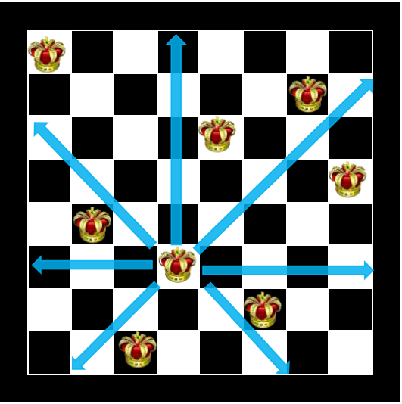
N- Queen Problem
The problem is to place n queens on an N-by-N chessboard so that no two queens attack each other .
No two Queens can be placed in same row.
No two Queens Can be places in same Column
No two queens Can be placed in same Diagonal.
Observation:
Case1 : N=1 Case 2 : N=2 Case 3 : N=3 [N=1,2,3 are not possible ]
Case 4 : N=4 Case 5 : N=5
So, on…….
The solution possibilities are discovered only up to 23 queen by backtracking approach.

Slide 8

N- Queen Problem
Backtracking approach : N- Queen Problem
The idea is to place queens one by one in different columns, starting from the leftmost column.
When we place a queen in a column, we check for clashes with already placed queens.
In the current column, if we find a row for which there is no clash, we mark this row and column as part of the solution.
If we do not find such a row due to clashes then we backtrack and return false.

Slide 9
N- Queen Problem
Algorithm
1) Start in the leftmost column
2) If all queens are placed
return true
3) Try all rows in the current column.
Do following for every tried row.
a) If the queen can be placed safely in this row
then mark this [row, column] as part of the
solution and recursively check if placing
queen here leads to a solution.
b) If placing the queen in [row, column] leads to
a solution then return true.
c) If placing queen doesn't lead to a solution then
unmark this [row, column] (Backtrack) and go to
step (a) to try other rows.
4) If all rows have been tried and nothing worked,
return false to trigger backtracking.

Slide 10


N- Queen Problem
Consider, 4 Queens

Slide 11
4- Queen Problem

Slide 12
4- Queen Problem

Slide 13
4- Queen Problem

Slide 14
4- Queen Problem

Slide 15
4- Queen Problem

Slide 16
4- Queen Problem

Slide 17
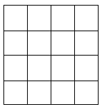
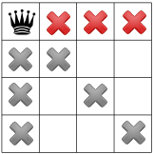
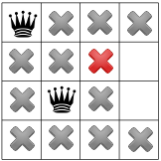
N- Queen Problem
4- Queen Problem Solution: find a false movements

Slide 18
4- Queen Problem

Slide 19
4- Queen Problem

Slide 20
4- Queen Problem

Slide 21
4- Queen Problem

Slide 22
4- Queen Problem

Slide 23
4- Queen Problem

Slide 24
4- Queen Problem

Slide 25
4- Queen Problem

Slide 26
4- Queen Problem

Slide 27
4- Queen Problem

Slide 28
4- Queen Problem

Slide 29
4- Queen Problem

Slide 30
4- Queen Problem

Slide 31
4- Queen Problem

Slide 32
4- Queen Problem

Slide 33
4- Queen Problem

Slide 34
4- Queen Problem

Slide 35




4- Queen Problem
TIO

Slide 36
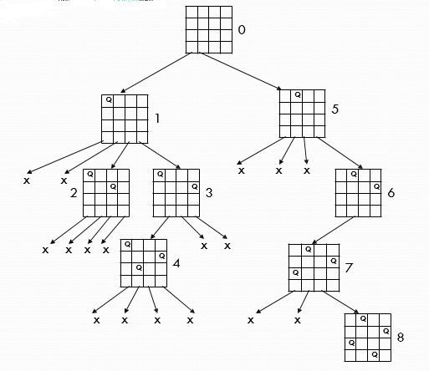
4- Queen Problem
4- Queen Problem Solution at a glance

Slide 37
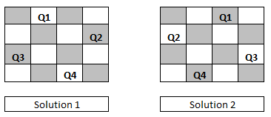
4- Queen Problem
4- Queen Problem Final Solution
In 4 queen problem there have only two solutions, one solution is mirror with another.

Slide 38
N- Queen Problem
bool solveNQUtil(int board[N][N], int col)
{
if (col >= N)
return true;
for (int i = 0; i < N; i++)
{
if (isSafe(board, i, col))
{
board[i][col] = 1;
if (solveNQUtil(board, col + 1))
return true;
board[i][col] = 0; // BACKTRACK
}
}
return false;
}
base case: If all queens are placed then return true
Check if the queen can be placed on board[i][col]
Place this queen in board[i][col]
recur to place rest of the queens
If placing queen in board[i][col] doesn't lead to a solution, then remove queen from board[i][col]
If the queen cannot be placed in any row in
this column col then return false

Slide 39
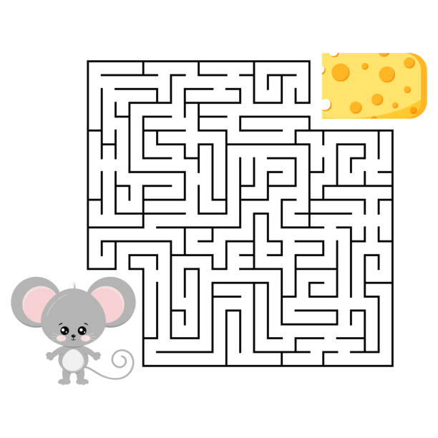
Rat in a Maze Puzzles

Slide 40
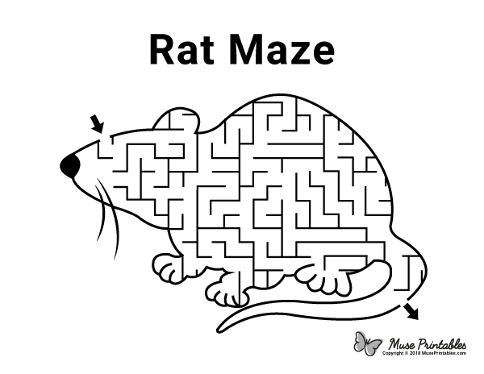
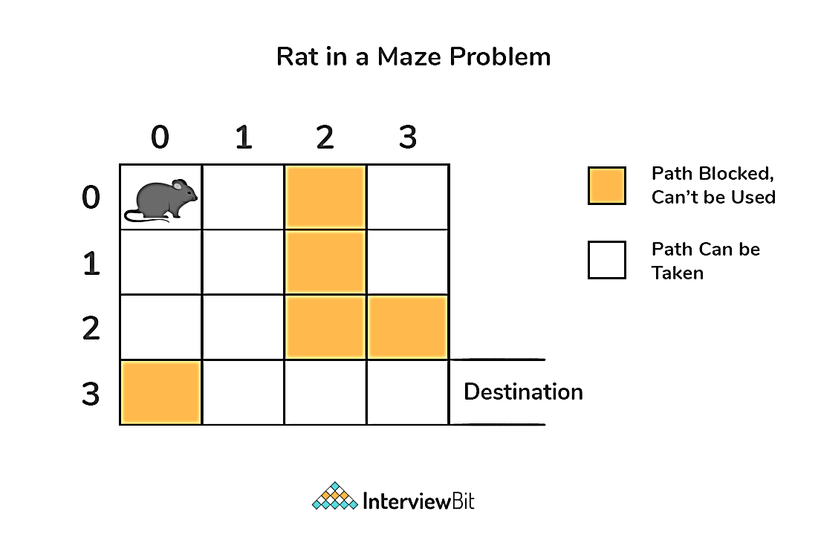
Rat in a Maze Puzzles
Problem
Given a maze, NxN matrix. A rat has to find a path from source to destination. maze[0][0] (left top corner)is the source and maze[N-1][N-1](right bottom corner) is destination. There are few cells which are blocked, means rat cannot enter into those cells. Rat can move in any direction ( left, right, up and down).

Slide 41
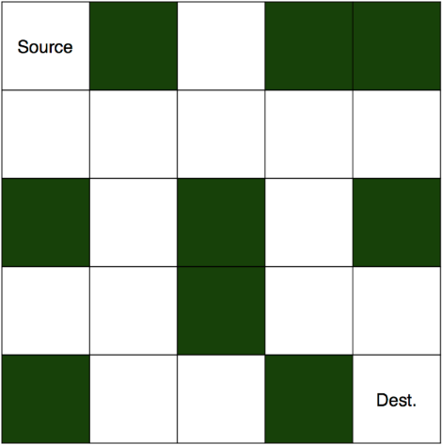
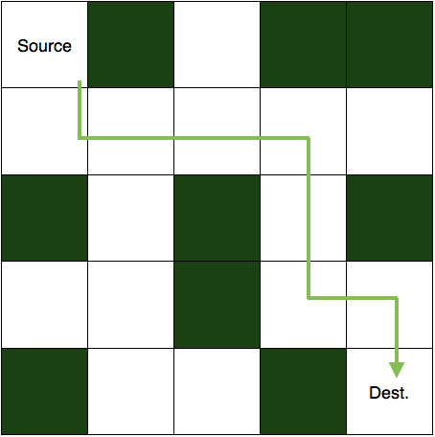
Rat in a Maze Puzzles
Rat in a Maze Problem when movement in all possible directions is allowed
Solution Algorithm
Start from the initial index (i.e. (0,0)) and look for the valid moves through the adjacent cells in the order Down->Left->Right->Up (so as to get the sorted paths) in the grid.
If the move is possible, then move to that cell while storing the character corresponding to the move(D,L,R,U) and again start looking for the valid move until the last index (i.e. (n-1,n-1)) is reached.
Also, keep on marking the cells as visited and when we traversed all the paths possible from that cell, then unmark that cell for other different paths and remove the character from the path formed.
As the last index of the grid(bottom right) is reached, then store the traversed path.
Time Complexity: O(2^(n^2)).

Slide 42
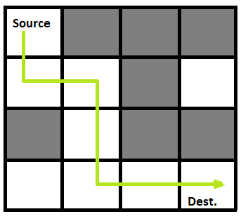
Rat in a Maze Puzzles
if(r>=0 && c>=0 && r<SIZE && c<SIZE && solution[r][c] == 0 && maze[r][c] == 0)
{
//if safe to visit then visit the cell
solution[r][c] = 1;
//going down
if(solvemaze(r+1, c))
return 1;
//going right
if(solvemaze(r, c+1))
return 1;
//going up
if(solvemaze(r-1, c))
return 1;
//going left
if(solvemaze(r, c-1))
return 1;
//backtracking
solution[r][c] = 0;
return 0;
}

Slide 43
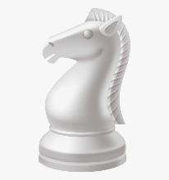
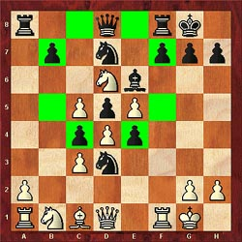
Knight's tour Problem

Slide 44
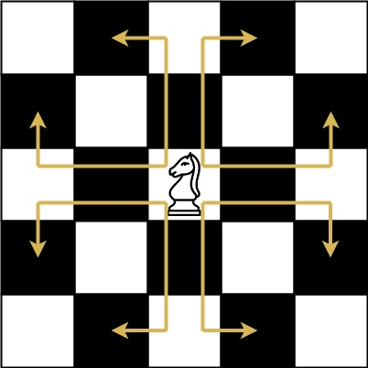
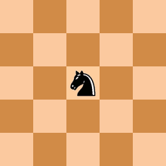
Knight's tour Problem
In chess, we know that the knight can jump in a special manner. It can move either two squares horizontally and one square vertically or two squares vertically and one square horizontally in each direction, So the complete movement looks like English letter ‘L’.
In this problem, there is an empty chess board, and a knight starting from any location in the board, our task is to check whether the knight can visit all of the squares in the board or not.
When It can visit all of the squares, then place the number of jumps needed to reach that location from the starting point.

Slide 45
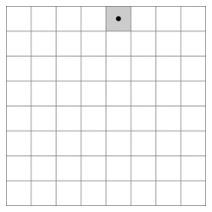
Knight's tour Problem
The knight's tour problem is an instance of the more general Hamiltonian path problem in graph theory. The problem of finding a closed knight's tour is similarly an instance of the Hamiltonian cycle problem. Unlike the general Hamiltonian path problem, the knight's tour problem can be solved in linear time.
There are two kinds of knight’s tours, a closed knight’s tour and an open knight’s tour:
A closed knight’s tour is one in which the knight’s last move in the tour places it a single move away from where it started
An open knight’s tour is one in which the knight’s last move in the tour places it on a square that is not a single move away from where it started
An open knight's tour of a chessboard

Slide 46
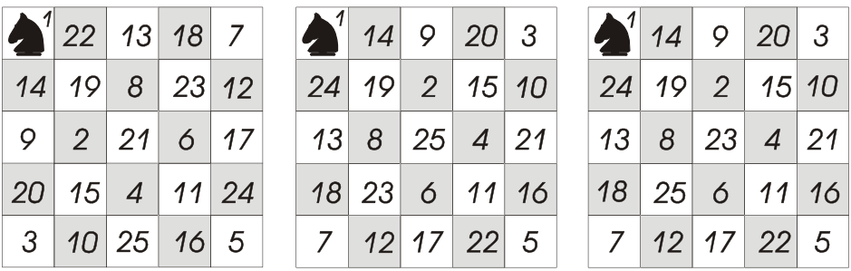
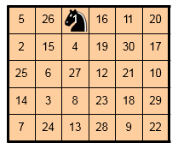
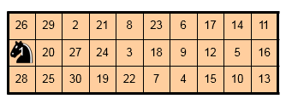
Knight's tour Problem
Different solutions of Knight's tour Problem
5*5 close knight tour
3*10 close knight tour
5*6 close knight tour

Slide 47
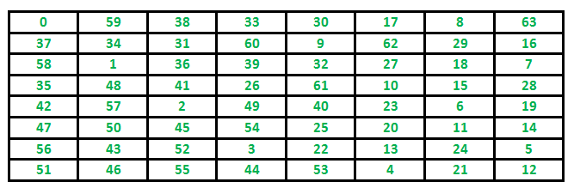
Knight's tour Problem
The path followed by Knight to cover all the cells Following is a chessboard with 8 x 8 cells. Numbers in cells indicate the move number of Knight.

Slide 48

How many closed knight’s tours are there on an 8 × 8 board?
How many open knight’s tours are there on an 8 × 8 board?
100 ??
1000 ??
10000??
No No No… it is biggerrrrrr
26,534,728,821,064
If we have to find all the closed paths every
human has to find 3500 diff paths
Population of world 7 billion but no of paths are
26 trillion
19,591,828,170,979,904
19 Quadrillion

Slide 49
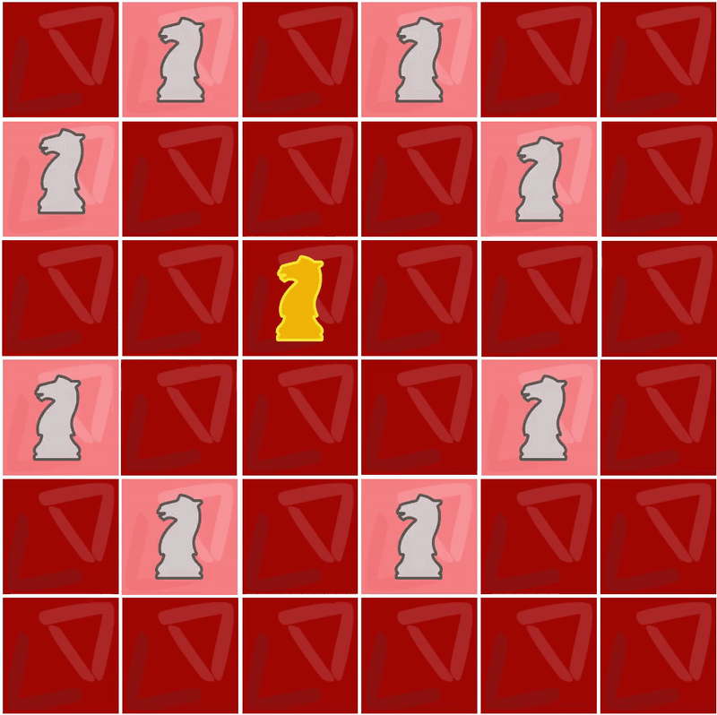
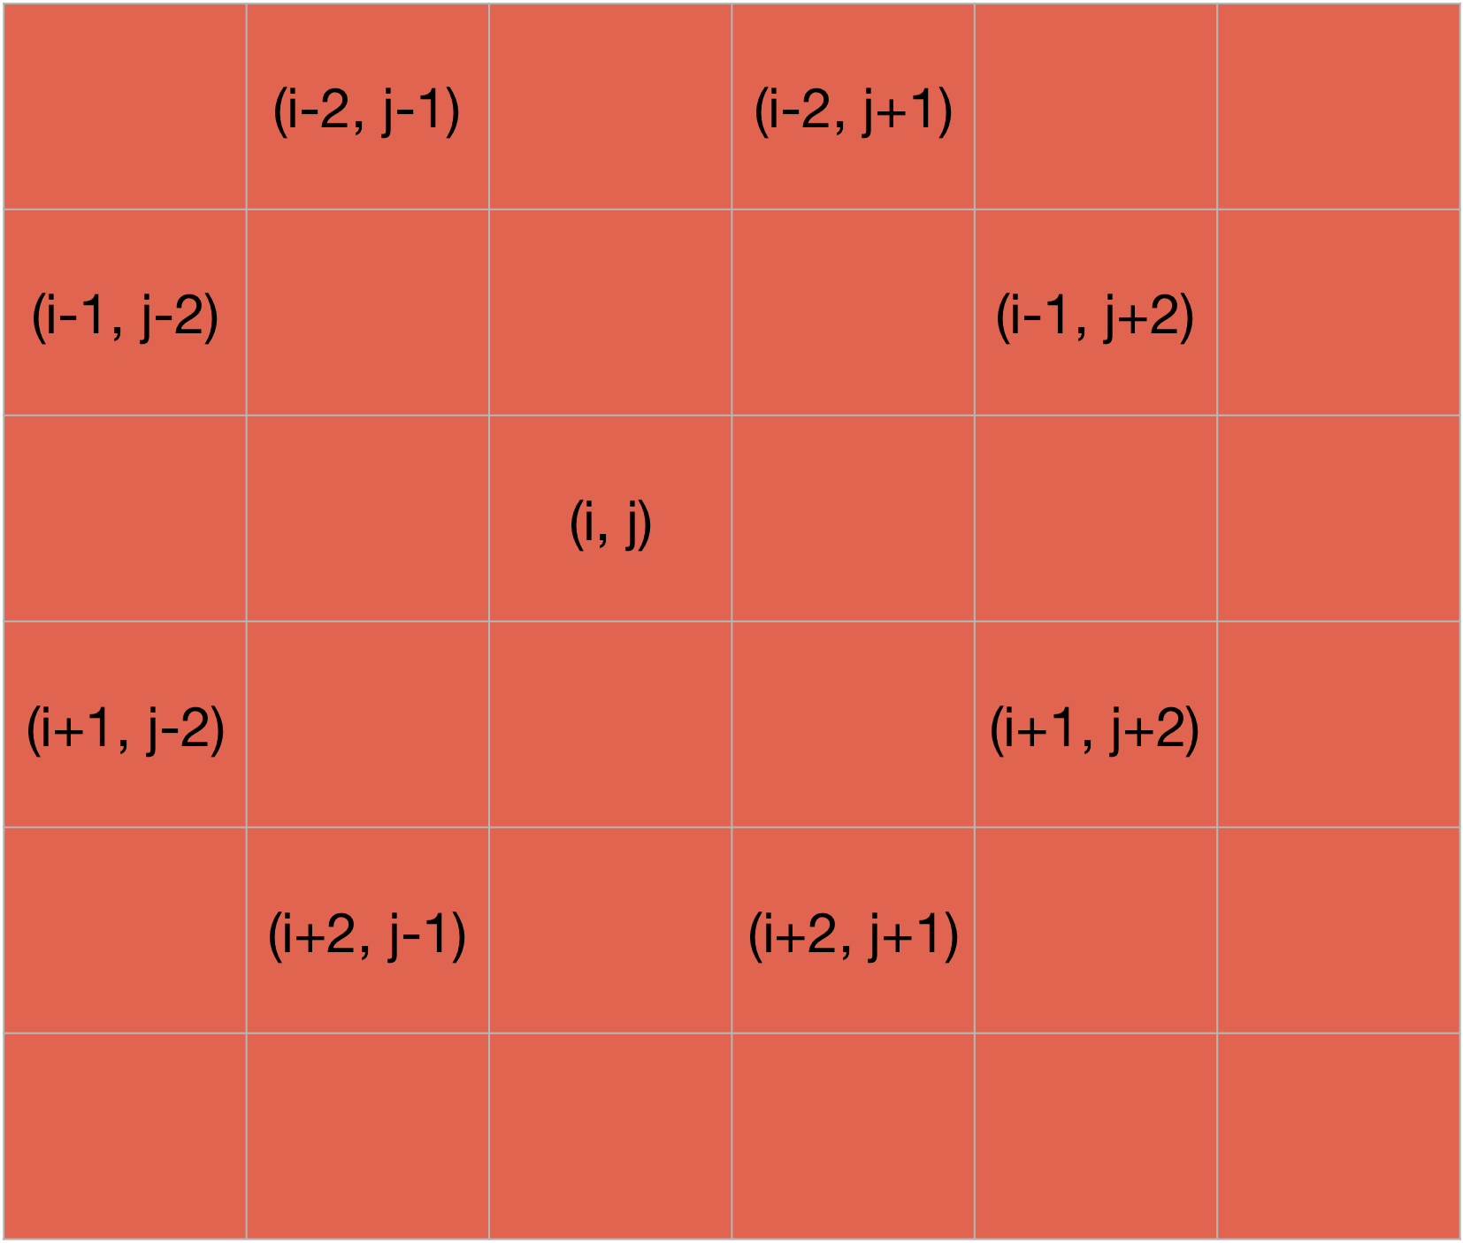
Knight's tour Problem
the knight can move to from the given location by using the array that stores the relative position of knight movement from any location
row[8] = {2, 1, -1, -2, -2, -1, 1, 2 };
column[8] = {1, 2, 2, 1, -1, -2, -2, -1 };

Slide 50
Knight's tour Problem
isValid(x, y, solution)
Begin
if 0 ≤ x ≤ Board Size and 0 ≤ y ≤ Board Size, and (x, y) is empty, then
return true
End
knightTour(x, y, move, sol, xMove, yMove)
Begin
if move = Board Size * Board Size, then //when all squares are visited
return true
for k := 0 to number of possible xMovement or yMovement, do
xNext := x + xMove[k]
yNext := y + yMove[k]
if isValid(xNext, yNext, sol) is true, then
sol[xNext, yMext] := move
if knightTour(xNext, yNext, move+1, sol, xMove, yMove), then
return true
else
remove move from the sol[xNext, yNext] to backtrack
done
return false
End

Slide 51
Knight's tour Problem
int knightTour(int x, int y, int move, int sol[N][N], int xMove[N], int yMove[N])
{
int xNext, yNext;
if (move == N*N)
return true;
for (int k = 0; k < 8; k++)
{
xNext = x + xMove[k];
yNext = y + yMove[k];
if (isValid(xNext, yNext, sol))
{
sol[xNext][yNext] = move;
if (knightTour(xNext, yNext, move+1, sol, xMove, yMove) == true)
return true;
else
sol[xNext][yNext] = -1;// backtracking
}
}
return false;
}
//all possible moves for knight
int xMove[8] = { 2, 1, -1, -2, -2, -1, 1, 2 };
int yMove[8] = { 1, 2, 2, 1, -1, -2, -2, -1 };

Slide 52
Additional Problem Based on Backtracking
Remove Invalid Parenthesis
Match a pattern and string using regular expression
Find Path from corner cell to middle cell in a maze
Hamiltonian cycle
Sudoku
M Coloring Problem
Rat in a Maze
Print all permutations of a given string
Shortest safe route in a path with landmines
Print palindromic partitions string
Subset sum

Slide 53
Reference
https://www.geeksforgeeks.org/top-20-backtracking-algorithm-interview-questions/

Slide 54

Thanks to All

